Slide 1

Decision Trees (โมเดลต้นไม้ตัดสินใจ) & Random Forest (โมเดลป่าแบบสุ่ม)

Slide 2
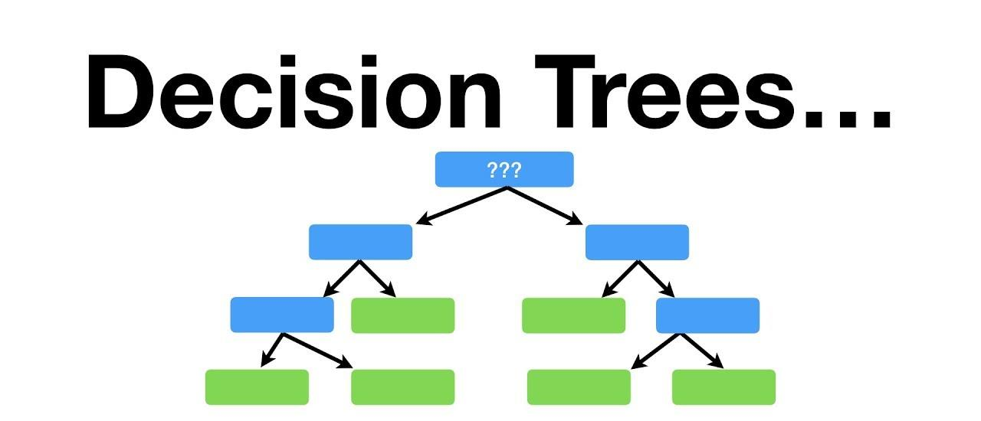
Decision Trees : โมเดลต้นไม้ตัดสินใจ
Machine Learning Model

Slide 3
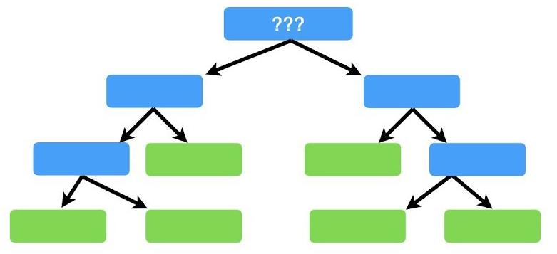
Decision Trees : โมเดลต้นไม้ตัดสินใจ
TRAIN DATA
MODEL
Features
Target
Pclass | Sex | Age | SibSp | Parch | Survived
3 | male | 22 | 1 | 0 | 0
1 | female | 38 | 1 | 0 | 1
3 | female | 26 | 0 | 0 | 1
1 | female | 35 | 1 | 0 | 1
3 | male | 35 | 0 | 0 | 0
3 | male | 30 | 0 | 0 | 0
1 | male | 54 | 0 | 0 | 0
3 | female | 27 | 0 | 2 | 1
.. | .. | .. | .. | .. | ..

Slide 4
Decision Trees : โมเดลต้นไม้ตัดสินใจ
Data Preparation : การเตรียมข้อมูล
Modeling : การสร้างโมเดล
Evaluation : การวัดประสิทธิภาพโมเดล

Slide 5
Decision Trees : โมเดลต้นไม้ตัดสินใจ
#install.packages(c("rpart", "rpart.plot"))
library(rpart)
library(rpart.plot)
titanic_train <- read.csv("C:\\R_Code\\Week-3\\titanic_train.csv")
titanic_test <- read.csv("C:\\R_Code\\Week-3\\titanic_test.csv")
titanic_train$Survived <- as.factor(titanic_train$Survived)
titanic_test$Survived <- as.factor(titanic_test$Survived)
tree_fit <- rpart(Survived ~ ., data = titanic_train)
p <- predict(tree_fit, newdata = titanic_test,type = "class")
mean(p == titanic_test$Survived)
rpart.plot(tree_fit)
การเตรียมข้อมูล
การสร้างโมเดล
การวัดประสิทธิภาพโมเดล

Slide 6
Data Preparation : การเตรียมข้อมูล
titanic_train <- read.csv("C:\\R_Code\\Week-3\\titanic_train.csv")
titanic_test <- read.csv("C:\\R_Code\\Week-3\\titanic_test.csv")
TRAIN DATA
TEST DATA
titanic_train
titanic_test
Pclass | Sex | Age | SibSp | Parch | Survived
3 | male | 22 | 1 | 0 | 0
1 | female | 38 | 1 | 0 | 1
3 | female | 26 | 0 | 0 | 1
1 | female | 35 | 1 | 0 | 1
3 | male | 35 | 0 | 0 | 0
3 | male | 30 | 0 | 0 | 0
1 | male | 54 | 0 | 0 | 0
3 | female | 27 | 0 | 2 | 1
.. | .. | .. | .. | .. | ..
Pclass | Sex | Age | SibSp | Parch | Survived
3 | male | 34.5 | 0 | 0 | 0
3 | female | 47 | 1 | 0 | 1
2 | male | 62 | 0 | 0 | 0
3 | male | 27 | 0 | 0 | 0
3 | female | 22 | 1 | 1 | 1
3 | male | 14 | 0 | 0 | 0
3 | female | 30 | 0 | 0 | 1
2 | male | 26 | 1 | 1 | 0
.. | .. | .. | .. | .. | ..

Slide 7
Modeling : การสร้างโมเดล
tree_fit <- rpart ( Survived ~ . , data = titanic_train )
TRAIN DATA
titanic_train
Pclass | Sex | Age | SibSp | Parch | Survived
3 | male | 22 | 1 | 0 | 0
1 | female | 38 | 1 | 0 | 1
3 | female | 26 | 0 | 0 | 1
1 | female | 35 | 1 | 0 | 1
3 | male | 35 | 0 | 0 | 0
3 | male | 30 | 0 | 0 | 0
1 | male | 54 | 0 | 0 | 0
3 | female | 27 | 0 | 2 | 1
.. | .. | .. | .. | .. | ..
DT MODEL
tree_fit

Slide 8
Evaluation : การวัดประสิทธิภาพโมเดล
p <- predict ( tree_fit , newdata = titanic_test , type = "class")
DT MODEL
TEST DATA 418 Records.
titanic_test
Pclass | Sex | Age | SibSp | Parch | Survived
3 | male | 34.5 | 0 | 0 | 0
3 | female | 47 | 1 | 0 | 1
2 | male | 62 | 0 | 0 | 0
3 | male | 27 | 0 | 0 | 0
3 | female | 22 | 1 | 1 | 1
3 | male | 14 | 0 | 0 | 0
3 | female | 30 | 0 | 0 | 1
2 | male | 26 | 1 | 1 | 0
.. | .. | .. | .. | .. | ..
tree_fit
VECTOR : Factor(“0”,”1”)
p
1 2 3 4 5 6 7 8 9 10 11 12 13 14 15 16 17
0 0 0 0 1 0 0 0 1 0 0 0 1 0 1 1 0
18 19 20 21 22 23 24 25 26 27 28 29 30 31 32 33 34
0 1 0 0 0 1 0 1 0 1 0 0 0 0 0 0 0
...
409 410 411 412 413 414 415 416 417 418
0 1 0 1 0 0 1 0 0 0

Slide 9
Evaluation : การวัดประสิทธิภาพโมเดล
mean ( p == titanic_test$Survived )
VECTOR : Factor(“0”,”1”)
TEST DATA 418 Records.
titanic_test
Pclass | Sex | Age | SibSp | Parch | Survived
3 | male | 34.5 | 0 | 0 | 0
3 | female | 47 | 1 | 0 | 1
2 | male | 62 | 0 | 0 | 0
3 | male | 27 | 0 | 0 | 0
3 | female | 22 | 1 | 1 | 1
3 | male | 14 | 0 | 0 | 0
3 | female | 30 | 0 | 0 | 1
2 | male | 26 | 1 | 1 | 0
.. | .. | .. | .. | .. | ..
p
1 2 3 4 5 6 7 8 9 10 11 12 13 14 15 16 17
0 0 0 0 1 0 0 0 1 0 0 0 1 0 1 1 0
18 19 20 21 22 23 24 25 26 27 28 29 30 31 32 33 34
0 1 0 0 0 1 0 1 0 1 0 0 0 0 0 0 0
...
409 410 411 412 413 414 415 416 417 418
0 1 0 1 0 0 1 0 0 0
> mean(p == titanic_test$Survived)
[1] 0.9019139
Accuracy
90.19%

Slide 10
Evaluation : การวัดประสิทธิภาพโมเดล
table(p , titanic_test$Survived)
90.19..
0.9019..
377/418
377
> table(p,titanic_test$Survived)
p 0 1
0 267 31
1 10 110
Confusion Matrix
267
110
+
100
x
267
110
10
31
+
+
+

Slide 11
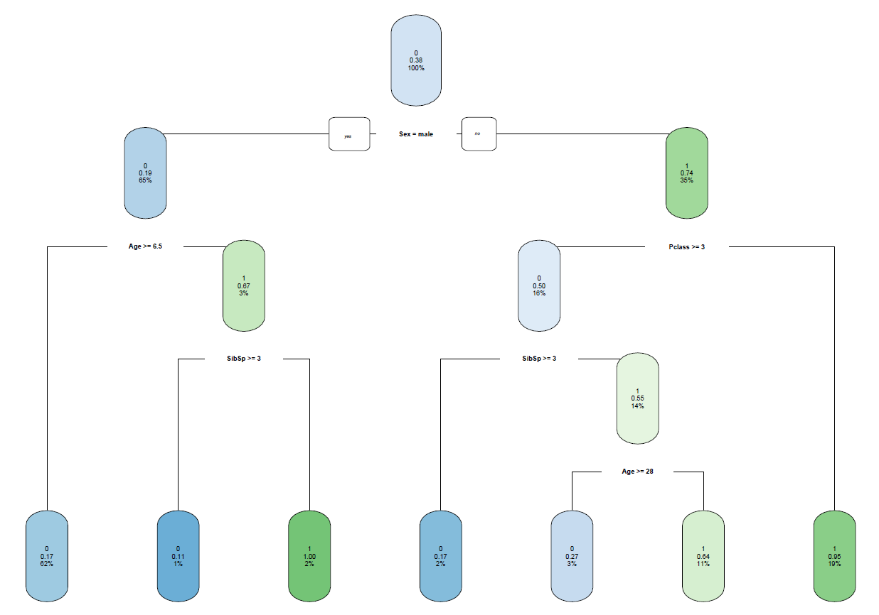
Evaluation : การวัดประสิทธิภาพโมเดล
rpart.plot(tree_fit)

Slide 12
Additional: เพิ่มเติม
#install.packages("party")
library(party)
titanic_train <- read.csv("C:\\R_Code\\Week-3\\titanic_train.csv")
titanic_test <- read.csv("C:\\R_Code\\Week-3\\titanic_test.csv")
titanic_train$Survived <- as.factor(titanic_train$Survived)
titanic_test$Survived <- as.factor(titanic_test$Survived)
#tree_fit <- rpart(Survived ~ ., data = titanic_train)
tree_fit <- ctree(Survived ~ ., data = titanic_train)
#p <- predict(tree_fit, newdata = titanic_test,type = "class")
p <- predict(tree_fit, newdata = titanic_test)
mean(p == titanic_test$Survived)
#rpart.plot(tree_fit)
plot(tree_fit)

Slide 13
Additional: เพิ่มเติม
#install.packages(c("rpart", "rpart.plot"))
library(rpart)
library(rpart.plot)
titanic_train <- read.csv("C:\\R_Code\\Week-3\\titanic_train.csv")
titanic_test <- read.csv("C:\\R_Code\\Week-3\\titanic_test.csv")
titanic_train$Survived <- as.factor(titanic_train$Survived)
titanic_test$Survived <- as.factor(titanic_test$Survived)
tree_fit <- rpart(Survived ~ ., data = titanic_train)
p <- predict(tree_fit, newdata = titanic_test,type = "class")
mean(p == titanic_test$Survived)
rpart.plot(tree_fit)
การเตรียมข้อมูล
การสร้างโมเดล
การเลือกโมเดลด้วยค่า CP
การวัดประสิทธิภาพโมเดล

Slide 14
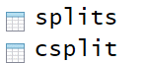
Additional: เพิ่มเติม
print(tree_fit$cptable) #Complexity Parameter
> print(tree_fit$cptable)
CP nsplit rel error xerror xstd
1 0.44444444 0 1.0000000 1.0000000 0.04244576
2 0.02534113 1 0.5555556 0.5555556 0.03574957
3 0.02339181 4 0.4795322 0.5146199 0.03474917
4 0.02046784 5 0.4561404 0.5087719 0.03459945
5 0.01000000 6 0.4356725 0.4824561 0.03390356
DT MODEL
tree_fit
tree_fit_final <- prune ( tree_fit , cp = 0.44444444 )
DT MODEL
tree_fit_final

Slide 15
Additional: เพิ่มเติม
#install.packages(c("rpart", "rpart.plot"))
library(rpart)
library(rpart.plot)
titanic_train <- read.csv("C:\\R_Code\\Week-3\\titanic_train.csv")
titanic_test <- read.csv("C:\\R_Code\\Week-3\\titanic_test.csv")
titanic_train$Survived <- as.factor(titanic_train$Survived)
titanic_test$Survived <- as.factor(titanic_test$Survived)
tree_fit <- rpart(Survived ~ ., data = titanic_train)
tree_fit_final <- prune( tree_fit , cp = 0.44444444 )
p <- predict(tree_fit_final, newdata = titanic_test,type = "class")
mean(p == titanic_test$Survived)
rpart.plot(tree_fit)
การเตรียมข้อมูล
การสร้างโมเดล
การเลือกโมเดลด้วยค่า CP
การวัดประสิทธิภาพโมเดล

Slide 16
Additional: เพิ่มเติม
table(p , titanic_test$Survived)
97.37%
0.9019..
377/418
377
> table(p,titanic_test$Survived)
p 0 1
0 266 0
1 11 141
Confusion Matrix
266
141
+
100
x
266
141
0
11
+
+
+

Slide 17
Additional: เพิ่มเติม
DT MODEL
tree_fit_final
CP
overfitting
underfitting
ทำงานได้แย่มาก
เมื่อเจอข้อมูลที่โมเดลไม่เคยเห็นมาก่อน
accuracy ต่ำลงxerror สูงขึ้น

Slide 18
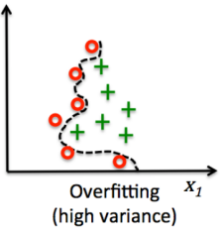
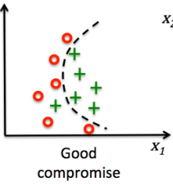
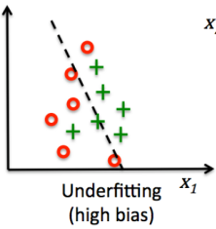
Additional: เพิ่มเติม

Slide 19


Random Forest : โมเดลป่าแบบสุ่ม
DECISION TREES MODEL

Slide 20
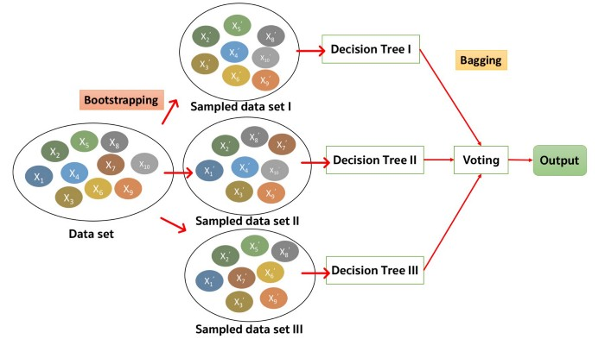

Random Forest : โมเดลป่าแบบสุ่ม
Machine Learning Model
Survived
DEAD
Survived
Survived

Slide 21
Random Forest : โมเดลป่าแบบสุ่ม
#install.packages("randomForest")
library(randomForest)
titanic_train <- read.csv("C:\\R_Code\\Week-3\\titanic_train.csv")
titanic_test <- read.csv("C:\\R_Code\\Week-3\\titanic_test.csv")
titanic_train$Survived <- as.factor(titanic_train$Survived)
titanic_test$Survived <- as.factor(titanic_test$Survived)
rf <- randomForest(Survived ~ .,data=titanic_train, ntree=100)
p <- predict(rf, newdata = titanic_test)
mean(p == titanic_test$Survived)
plot(rf)
plot(margin(rf,titanic_test$Survived))
library(party)
rf <- cforest(Survived ~ .,data=titanic_train)

Slide 22
Modeling : การสร้างโมเดล
rf <- randomForest( Survived ~ . , data = titanic_train )
Pclass | Sex | Age | SibSp | Parch | Survived
3 | male | 22 | 1 | 0 | 0
1 | female | 38 | 1 | 0 | 1
3 | female | 26 | 0 | 0 | 1
1 | female | 35 | 1 | 0 | 1
3 | male | 35 | 0 | 0 | 0
3 | male | 30 | 0 | 0 | 0
1 | male | 54 | 0 | 0 | 0
3 | female | 27 | 0 | 2 | 1
.. | .. | .. | .. | .. | ..
TRAIN DATA
titanic_train
RF MODEL
Default : 500 trees
rf

Slide 23
Modeling : การสร้างโมเดล
rf <- randomForest( Survived ~ . , data = titanic_train , ntree=1000 )
Pclass | Sex | Age | SibSp | Parch | Survived
3 | male | 22 | 1 | 0 | 0
1 | female | 38 | 1 | 0 | 1
3 | female | 26 | 0 | 0 | 1
1 | female | 35 | 1 | 0 | 1
3 | male | 35 | 0 | 0 | 0
3 | male | 30 | 0 | 0 | 0
1 | male | 54 | 0 | 0 | 0
3 | female | 27 | 0 | 2 | 1
.. | .. | .. | .. | .. | ..
TRAIN DATA
titanic_train
RF MODEL
Default : 1000 trees
rf

Slide 24
Evaluation : การวัดประสิทธิภาพโมเดล
table(p , titanic_test$Survived)
92.58%
0.9019..
377/418
377
> table(p,titanic_test$Survived)
p 0 1
0 263 17
1 14 124
Confusion Matrix
263
124
+
100
x
263
124
17
14
+
+
+

Slide 25
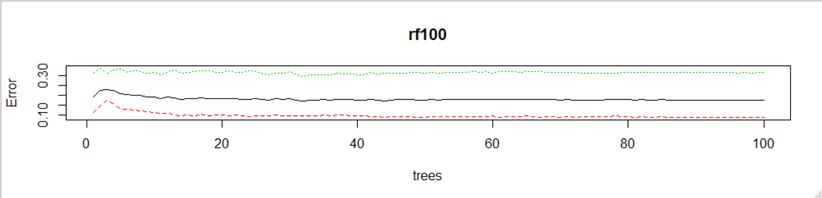
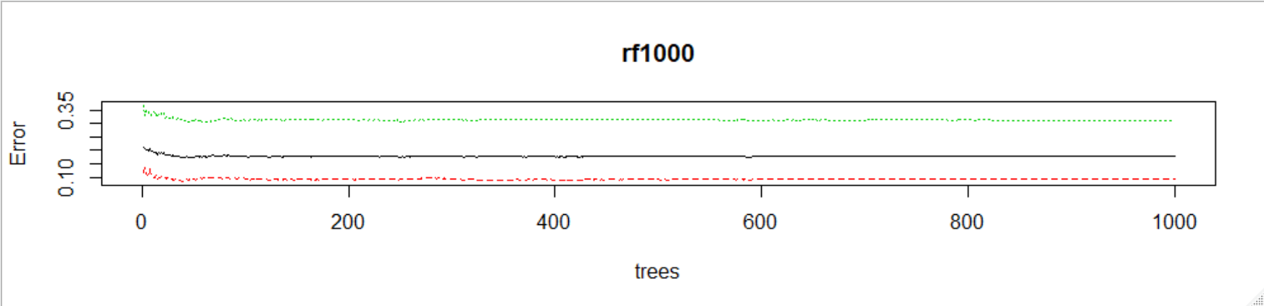
Random Forest : โมเดลป่าแบบสุ่ม
plot(rf) #rf100 และ rf1000

Slide 26
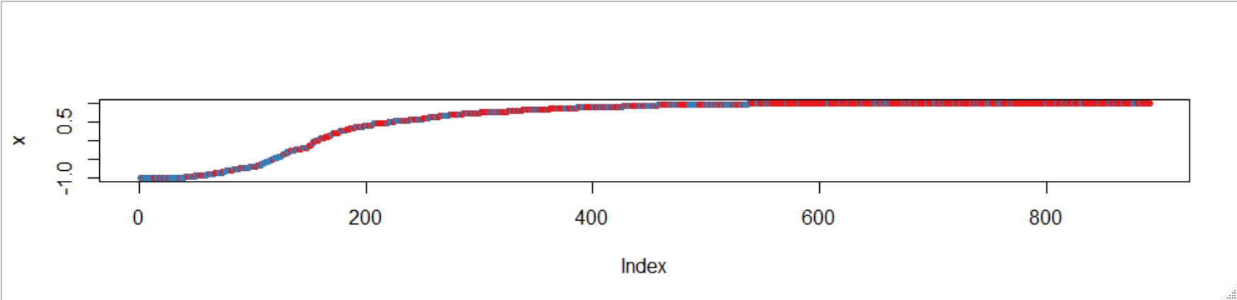
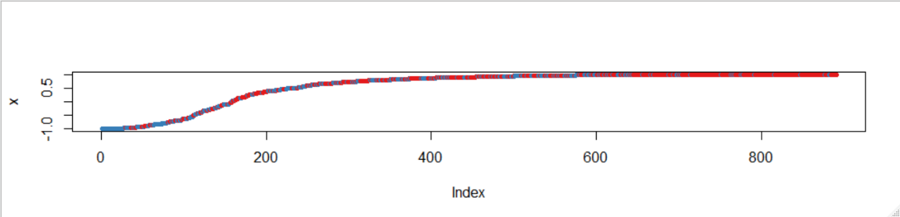
Random Forest : โมเดลป่าแบบสุ่ม
plot(margin(rf,titanic_test$Survived)) #rf100 และ rf1000

Slide 27
Random Forest : โมเดลป่าแบบสุ่ม
print(rf1000) #Dataset IRIS
> print(rf1000)
Call:
randomForest(formula = Species ~ ., data = df_train, ntree = 1000)
Type of random forest: classification
Number of trees: 1000
No. of variables tried at each split: 2
OOB estimate of error rate: 7.55%
Confusion matrix:
setosa versicolor virginica class.error
setosa 34 0 0 0.00000000
versicolor 0 31 3 0.08823529
virginica 0 5 33 0.13157895

Slide 28
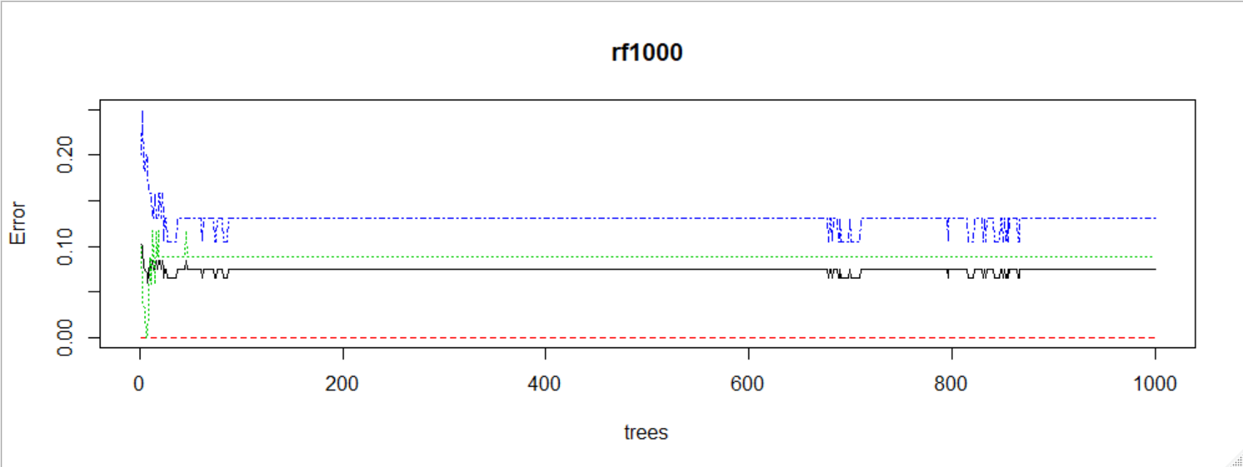
Random Forest : โมเดลป่าแบบสุ่ม
setosa versicolor virginica class.error
setosa 34 0 0 0.00000000
versicolor 0 31 3 0.08823529
virginica 0 5 33 0.13157895
plot(rf1000) #Dataset IRIS

Slide 29
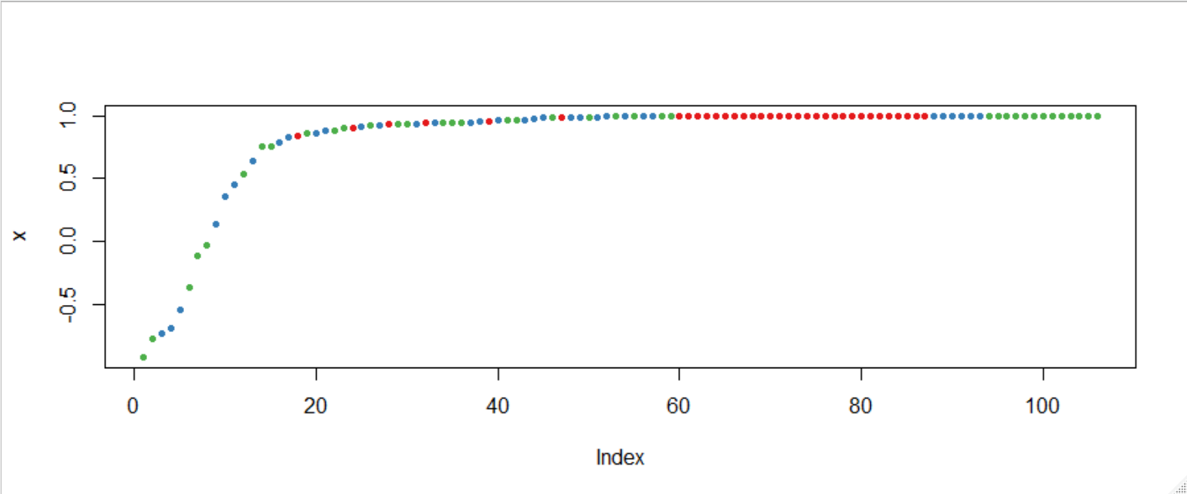
Random Forest : โมเดลป่าแบบสุ่ม
setosa versicolor virginica class.error
setosa 34 0 0 0.00000000
versicolor 0 31 3 0.08823529
virginica 0 5 33 0.13157895
plot(margin(rf1000,df_test$Species))

Slide 30
Random Forest : โมเดลป่าแบบสุ่ม
importance(rf) #rf100 และ rf1000
> importance(rf100)
MeanDecreaseGini
Pclass 47.20993
Sex 116.33599
Age 55.11193
SibSp 17.65580
Parch 11.90206
> importance(rf1000)
MeanDecreaseGini
Pclass 46.21342
Sex 113.29435
Age 57.09309
SibSp 18.31345
Parch 12.87700

Slide 31
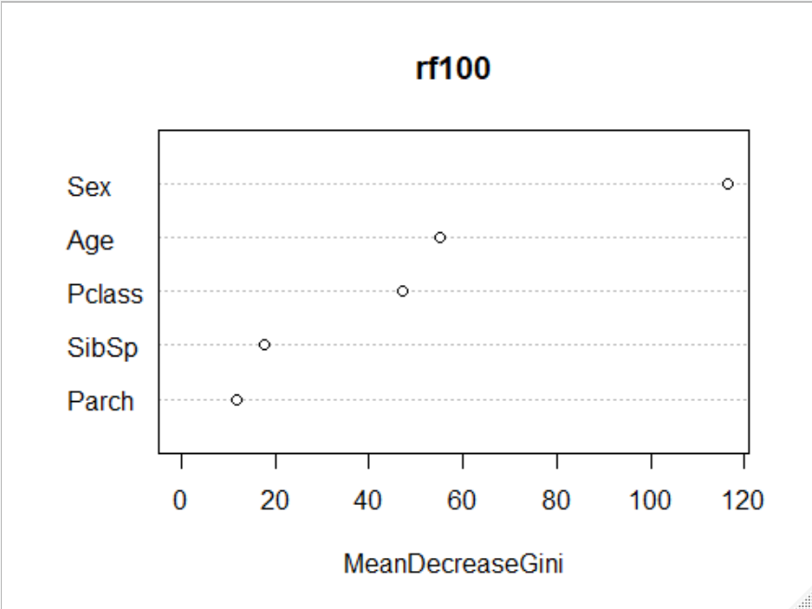
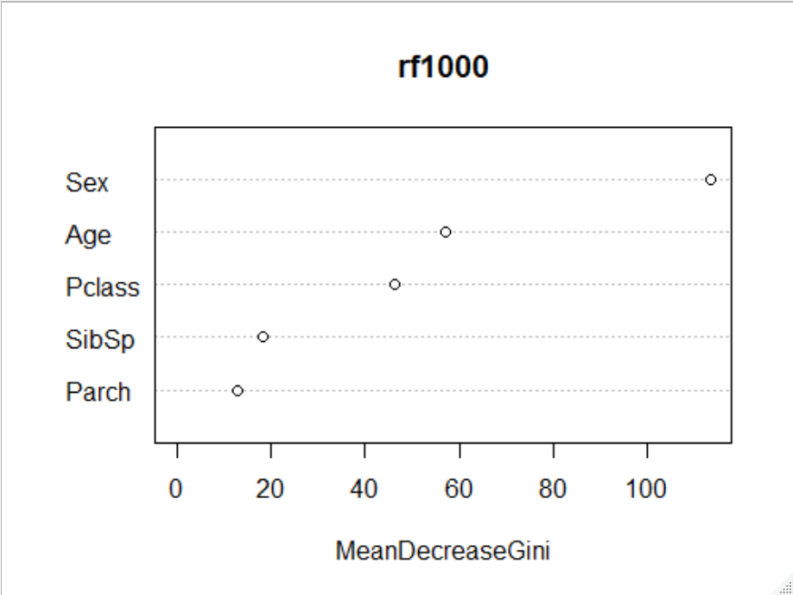
Random Forest : โมเดลป่าแบบสุ่ม
varImpPlot(rf) #rf100 และ rf1000

Slide 32

Conclusion : สรุป
Decision Trees
Random Forest
Overfitting
Reduce Overfitting
Low accuracy
More accuracy
Simpler and easier
Complex
Fast Training
Slow Training

